Slide 1
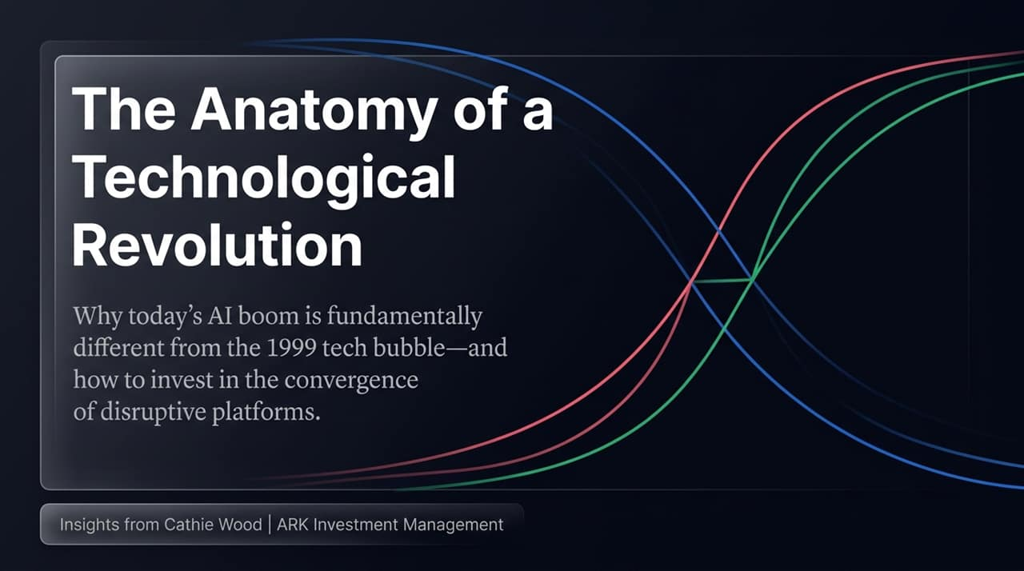
Notes:
Opening & Context:
Good morning, everyone. Today, we are exploring a question that defines modern portfolio management: Are we witnessing a repeat of the 1999 Dot-Com Tech Bubble, or are we experiencing a fundamental, multi-trillion-dollar technological shift?
In this presentation, drawing directly from Cathie Wood's insights at ARK Investment Management, we will unpack why today’s AI boom is structurally different from 1999—and how active investment must adapt to capture the convergence of disruptive platforms.
The Structural Thesis:
To understand where we are going, we must recognize that traditional market structures have undergone a massive shift since the 2008–2009 Global Financial Crisis.
Most of the asset management industry shifted toward passive indexing, benchmark-sensitive strategies, and short-term quarterly tracking.
This created a systemic blind spot: Wall Street began viewing technologically enabled innovation as pure risk rather than long-term growth, abandoning the deep, original research required to analyze exponentially growing technologies.
Transition to Next Slide:
Let's begin by contrasting the legacy investment paradigm with the reality of investing in disruptive innovation.
https://youtube.com/watch?v=1RBpOq62vwQ

Slide 2
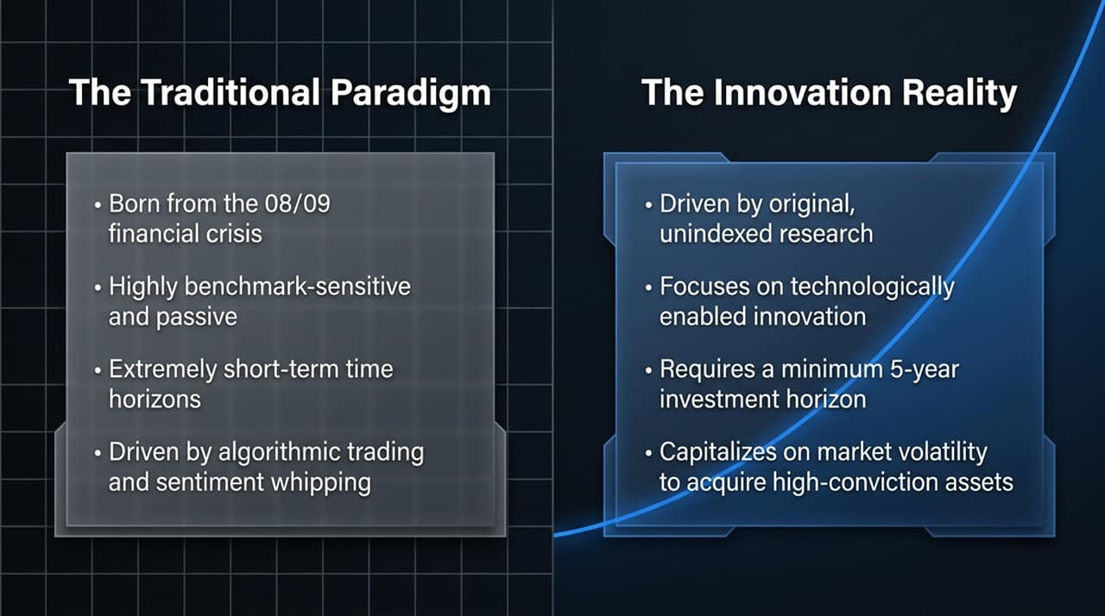
Notes:
The Legacy Trap (Left Side):
The left column illustrates the dominant market environment born out of 08/09. It is characterized by high benchmark sensitivity, extremely short time horizons, and high-frequency or algorithmic trading that whips market sentiment around daily.
This short-term focus creates irrational market reactions—where a minor quarterly earnings miss triggers a 10% or 15% sell-off, even when the company's 5-year underlying trajectory remains unchanged.
The Innovation Reality (Right Side):
On the right is the paradigm required to capture exponential growth. It requires original, unindexed research rooted in fundamental cost-decline mechanics—specifically Wright’s Law.
It demands a minimum 5-year investment horizon. Instead of fearing volatility, this framework capitalizes on short-term market dislocations to acquire high-conviction assets at discounted prices.
The A-R-K Framework:
Active: Complete departure from index overlap. If you simply mirror the S&P 500 or Nasdaq, you are exposing yourself to legacy incumbents vulnerable to disruption.
Research: Open-source, evolving analysis that engages directly with ecosystem developers, scientists, and industry innovators.
Knowledge: The relentless pursuit of technological truth over short-term market consensus.

Slide 3
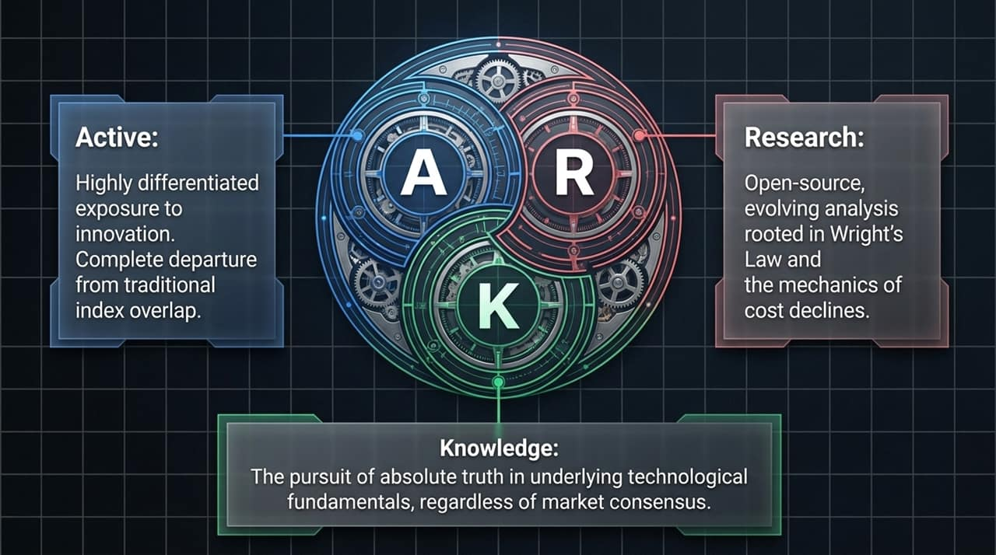
Notes:
Addressing the Skeptics:
The most common critique of today's AI enthusiasm is that 'we've seen this movie before in 1999.' However, comparing the underlying data reveals that today’s market structure is almost the exact inverse of 1999.
Technology Readiness:
In 1999, the market was pricing in concepts and seeds. The internet was real, but the necessary foundational infrastructure—such as Cloud Computing—didn't arrive until 2006. Key AI architectures like Transformer networks didn't emerge until 2017.
Today, the underlying technology is ready, tested, and actively generating value across enterprises globally.
Valuation Basis & Revenue Velocity:
In 1999, Wall Street justified sky-high valuations using 10-year speculative projections based on 'eyeballs' and web traffic.
Today, we are seeing unprecedented real-time revenue velocity. Look at Anthropic: its annualized revenue run rate surged from $9M to $47M in a span of just six months due to enterprise demand for Claude.
Capital Flow & Market Sentiment:
In 1999, venture capital and speculative public capital were chasing too few viable ideas.
Today, cash-rich hyperscalers (like Meta, Microsoft, Alphabet, and Amazon) are self-funding massive CAPEX investments out of their balance sheets.
Furthermore, 1999 was characterized by blind euphoria. Today’s market is defined by healthy skepticism and nervousness—which provides the necessary wall of worry for a bull market to climb.

Slide 4
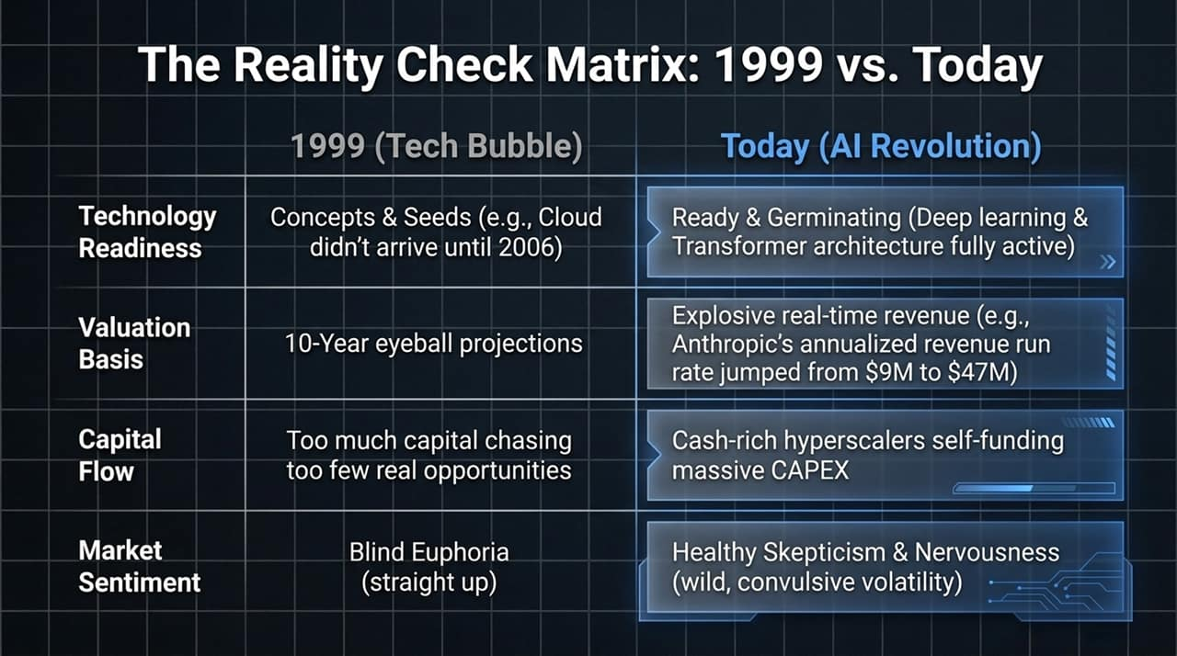
Notes:
Defining Wright’s Law:
At the core of technological forecasting is Wright’s Law, a concept originally formulated in aeronautics but applied here across technology platforms.
Wright’s Law states that for every cumulative doubling in units produced, costs decline by a consistent and predictable percentage.
Case Study: Whole Human Genome Sequencing:
Consider DNA sequencing as a classic example of this mechanic in action:
In 2003, sequencing the first whole human genome required $2.7 Billion and over a decade of effort.
Today, that same process costs under $100.
This 40% cost drop for every cumulative doubling created a structural cost collapse that opened up brand-new commercial markets.
Strategic Implication for Investors:
When a technology's unit economics drop dramatically, it destroys the pricing power of legacy incumbents while creating massive unit volume expansion for low-cost disruptors.

Slide 5
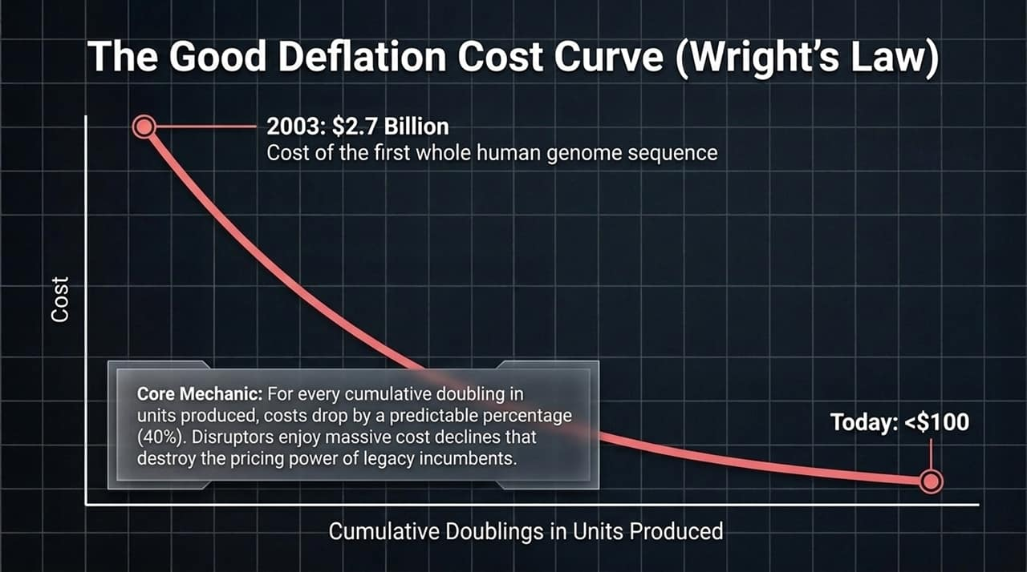
Notes:
Filter for Pure-Play Platforms:
Not every interesting technology is an investment platform. To qualify as a true Innovation Platform, a technology must satisfy three strict conditions:
Pillar 1: Declining Cost Curve:
It must follow a steep learning curve driven by Wright’s Law, as discussed on Slide 4.
Pillar 2: Cross-Sector Disruption:
As costs decline, the technology must become cheap enough to enter and transform multiple distinct industries. For example, AI isn't just a 'tech sector' story—it reshapes healthcare, manufacturing, finance, and transportation.
Pillar 3: Launchpad for Convergence:
Most importantly, the platform must serve as a building block that intersects with and accelerates other independent technologies.

Slide 6
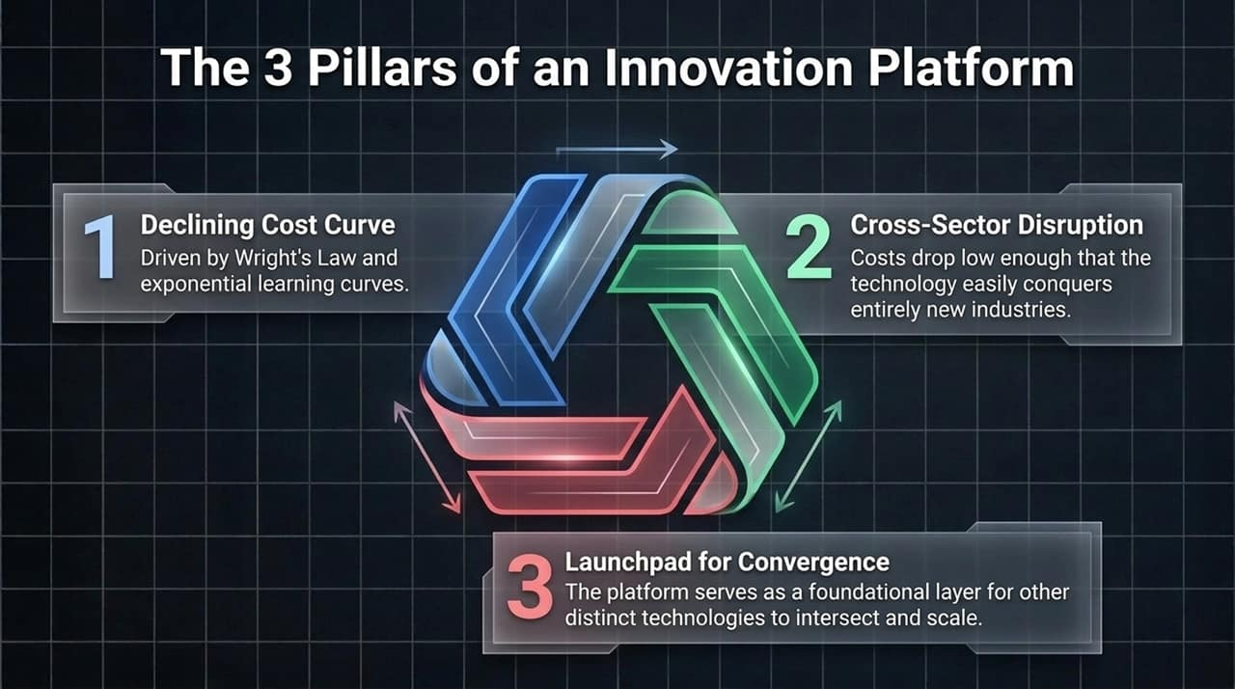
Notes:
Deconstructing the Stack:
To invest effectively in AI, we must analyze the three distinct layers of the software and hardware tech stack:
Layer 1: Infrastructure (Foundation):
This includes chips, compute infrastructure, data centers, and power grid capabilities (e.g., Nvidia, Cerebras).
Layer 2: Platform-as-a-Service (PaaS) - The New Core:
This is where enterprise value is concentrating. Companies like Palantir, OpenAI, and Anthropic allow enterprises to build custom models directly on top of their private, proprietary data.
Layer 3: Software-as-a-Service (SaaS) - Vulnerable Legacy:
Traditional SaaS applications are at risk of being displaced. Legacy SaaS relies on static, 'one-size-fits-all' licensing models.
As PaaS enables custom internal software built on tailored enterprise data, off-the-shelf SaaS seats are seeing reduced pricing power and market share erosion.

Slide 7
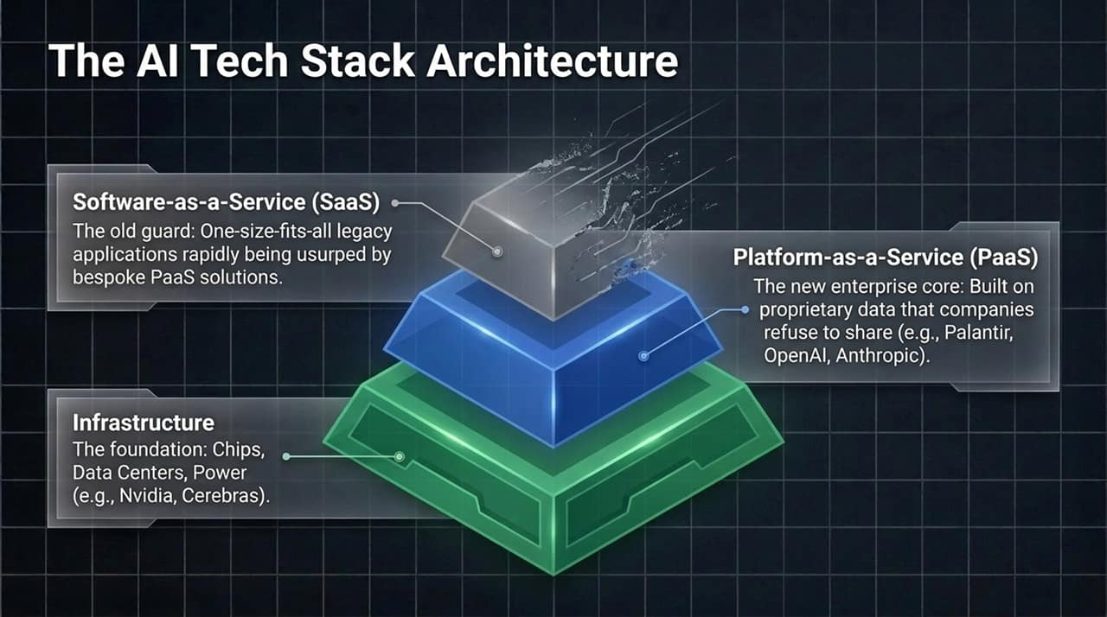
Notes:
Super-Exponential Growth:
When independent technological S-curves converge, growth does not add up linearly—it multiplies exponentially.
Case Study: The $10 Trillion Robo-Taxi Ecosystem:
Consider autonomous taxi fleets as an example of platform convergence:
Robotics: Autonomous vehicle platforms and sensors.
Energy Storage: Advanced electric battery systems.
Artificial Intelligence: Real-time neural net inference, computer vision, and routing.
Without any one of these three platforms, autonomous taxis cannot exist at scale.
Combined, they unlock an estimated $10 Trillion global market opportunity over the next decade.

Slide 8
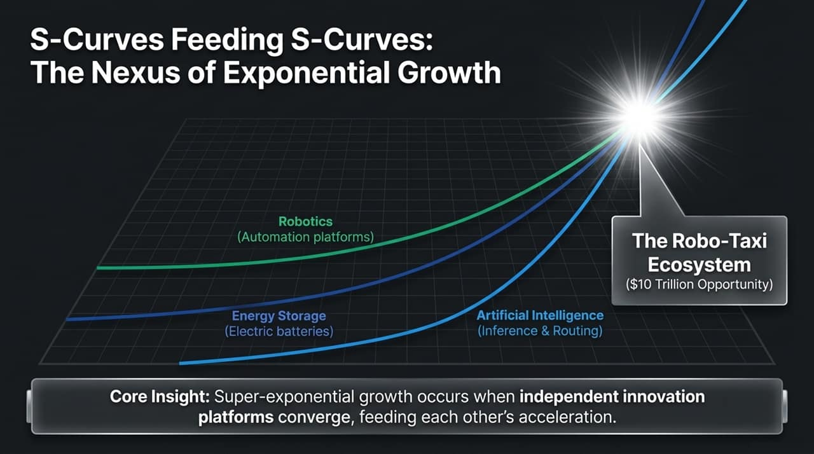
Notes:
Market Misperceptions & Extreme Skepticism:
Health care—specifically Multi-omics—is currently one of the most overlooked applications of AI.
During market downturns, the multi-omics space faced intense skepticism. At its lowest point, the ARKG ETF had a 60% short interest ratio.
Short sellers viewed biotech and genomics as too heavily regulated, politically vulnerable, and burdened by temporary negative cash flows.
The Convergence Reality in Healthcare:
In reality, the convergence of AI, Single-Cell Sequencing, and CRISPR Gene Editing creates an unprecedented biological breakthrough:
Single-Cell Sequencing + AI: Analyzes the 35–40 trillion cells in the human body to identify micro-mutations before symptoms appear.
CRISPR Gene Editing: Reprograms defective DNA sequences directly at the cellular level.

Slide 9
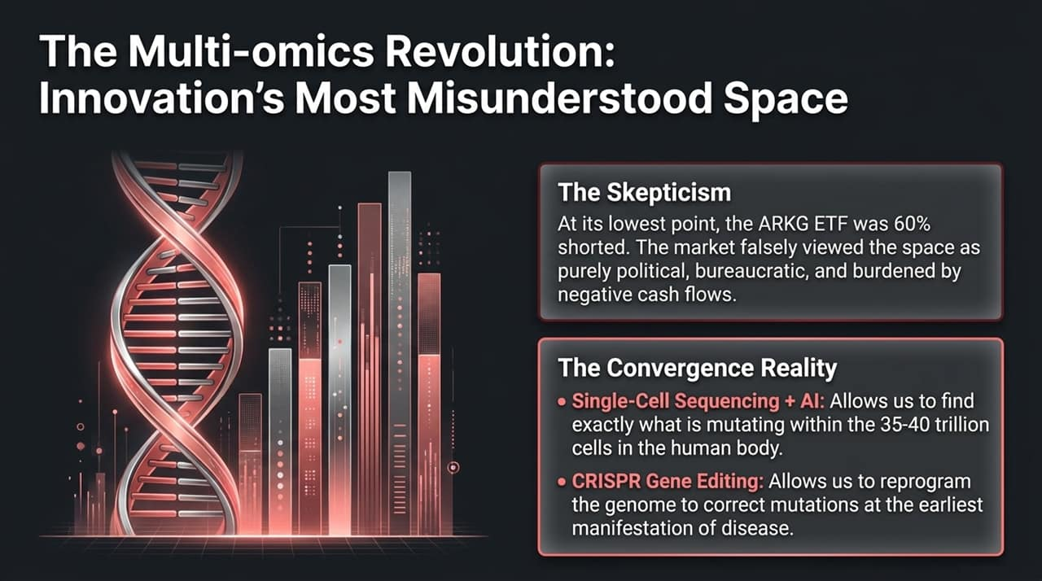
Notes:
Learning from Past Analytical Errors:
To maintain investment discipline, active managers must re-evaluate their theses continuously and admit when a technology fails to scale into an independent platform.
Dead-End Case Study 1: 3D Printing:
3D printing was initially viewed as an independent industry platform.
However, over time, 3D printing was absorbed simply as an automation feature within existing industrial, automotive, and aerospace manufacturing workflows.
Dead-End Case Study 2: Toyota’s Hydrogen Strategy:
Toyota heavily pursued hydrogen fuel cells due to Japanese post-Fukushima energy policy constraints.
However, the massive infrastructure buildout costs for hydrogen could not keep pace with global battery-electric vehicle (EV) learning curves, making hydrogen passenger vehicles economically unviable.
Key Takeaway:
If an innovation does not command its own cross-sector S-curve, it is a feature or feature set, not an investment platform.

Slide 10
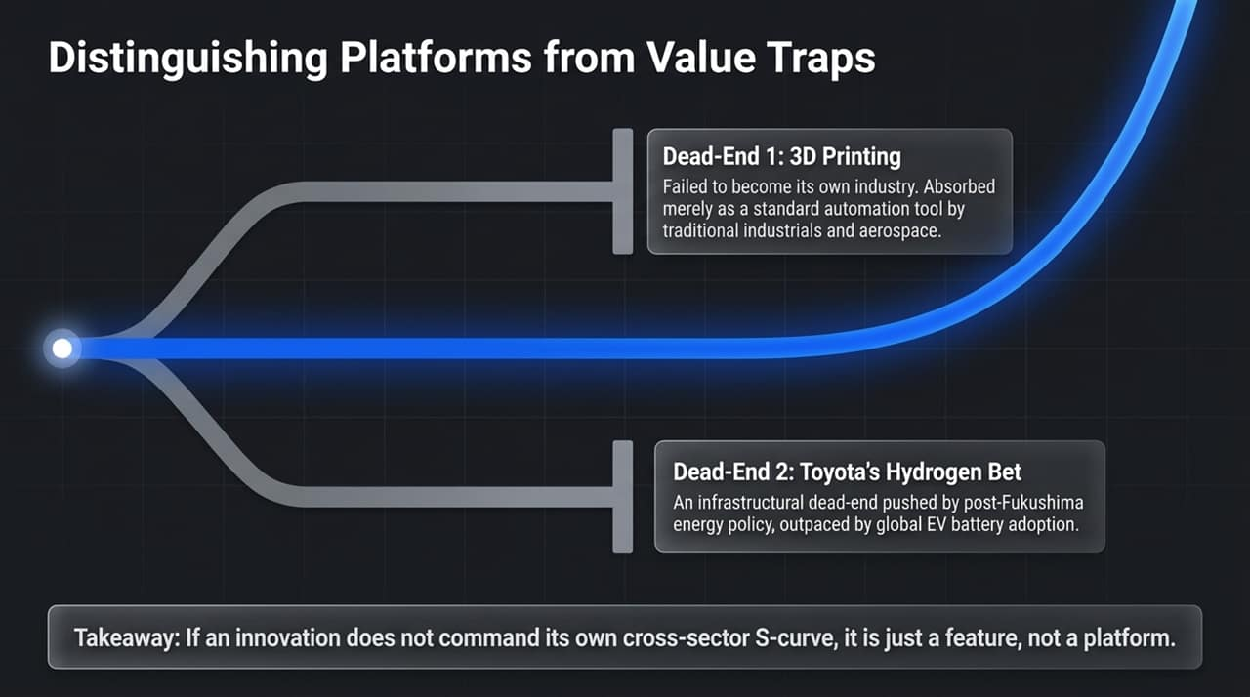
Notes:
Macro Environment: 'Good Deflation':
As Wright’s Law drives technology cost reductions, it creates a macro phenomenon called Good Deflation.
The Disruptors (Optimal Zone):
Disruptive platforms pass cost reductions directly to customers in the form of lower prices.
Because their cost structures fall faster than their prices, disruptors expand unit demand rapidly while maintaining healthy operating margins.
Traditional Incumbents (Danger Zone):
Legacy incumbents are stuck with high, rigid legacy cost structures.
To protect market share against low-cost disruptors, incumbents are forced to slash prices without a corresponding drop in cost structure—resulting in margin compression, debt restructuring, and severe dividend risk.
Case Study: Internal Combustion Engine (ICE) Auto Industry:
Traditional ICE automakers face structural headwinds as consumers transition toward autonomous electric vehicle fleets.

Slide 11
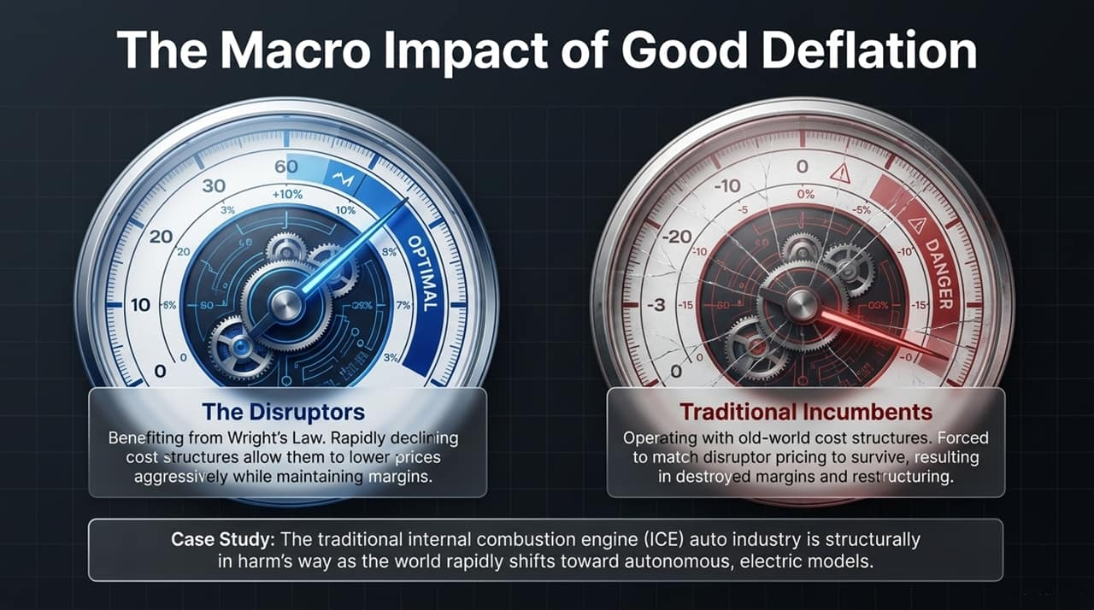
Notes:
Decoupling Volatility from Risk:
One of the most critical conceptual tasks for investors is distinguishing daily volatility from structural risk.
Volatility = Uncertainty & Market Sentiment:
Volatility is a function of short-term uncertainty.
It is amplified by high-frequency trading algorithms reacting to headlines, macroeconomic updates, or quarterly earnings noise.
Risk = Permanent Capital Impairment:
Real risk is the permanent impairment of capital caused by a failed investment thesis.
For example, when interrogating company management teams on AI strategy, some reveal their AI efforts to be 'only an inch deep'—merely checking a public relations box rather than deploying real technical architectures.

Slide 12
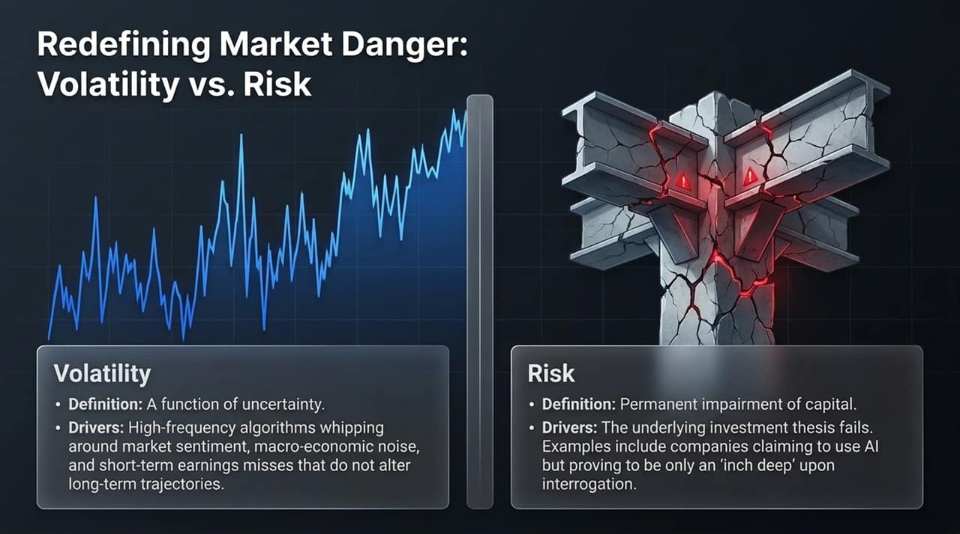
Notes:
Down Markets as Opportunities:
Rather than pulling back during market drawdowns, active managers use market corrections to strengthen portfolio conviction.
The 6-Metric Bottom-Up Scoring System:
During drawdowns, every portfolio company is systematically evaluated across a proprietary 6-metric bottom-up scoring model (evaluating moat, technology depth, management quality, balance sheet strength, and valuation).
Eliminating Uncertainty:
The funnel process forces capital out of secondary, lower-conviction holdings and concentrates it into top-tier platforms.
This approach removes structural thesis risk from the strategy while preserving long-term upside participation.

Slide 13
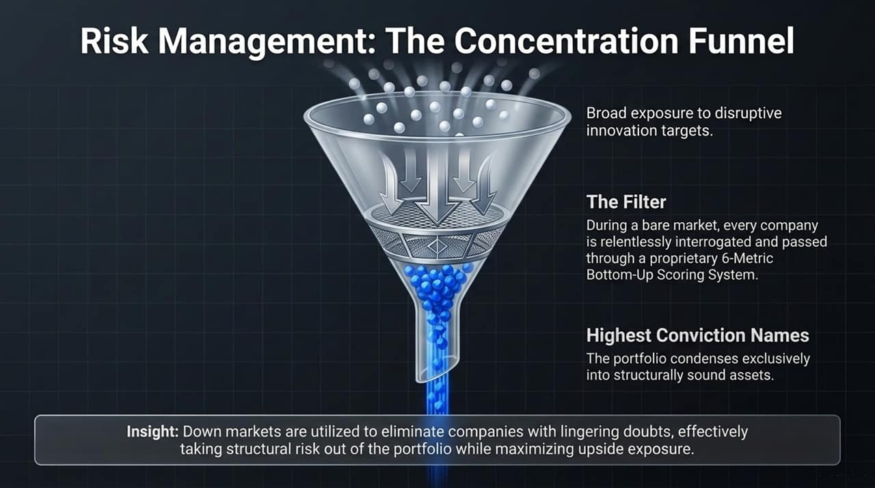
Notes:
The 5-Year Horizon Framework:
Short-term market participants demand cheap multiples today because they lack visibility into multi-year technology adoption curves.
Accounting for Multiple Decay:
When evaluating high-growth platforms in Year 1, active models factor in an assumed multiple compression over a 5-year period—assuming the valuation multiple will decay down toward a standard market multiple (e.g., 18–19x EBITDA) by Year 5.
The Principle of Overwhelming Force:
For an investment thesis to pass investment criteria, the company's projected revenue growth and margin expansion must be strong enough to completely offset this multiple decay.

Slide 14
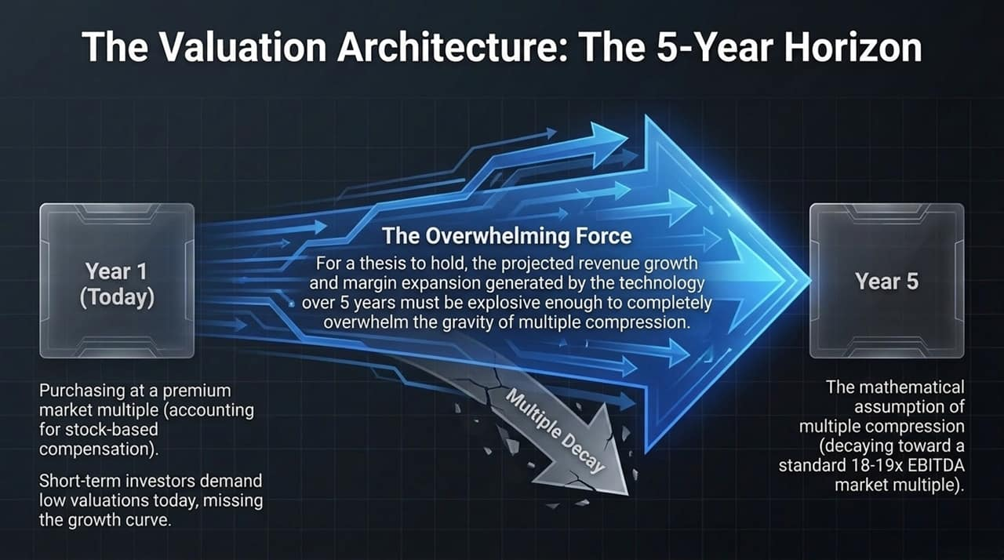
Notes:
How to Identify a Real Tech Bubble Top:
How will we know when this AI-driven technology cycle has reached its true peak?
It will not occur when investors are anxious, questioning hyper-scaler CAPEX, or debating valuation multiples.
As Cathie Wood notes: 'I will know this technology revolution has reached its peak when... the sky is the limit, when no one is worried about anything, and all the skepticism is gone.'
Current Market Position:
Today’s market is characterized by institutional skepticism, volatility, and strict cash flow accountability.
This skepticism provides the healthy discipline needed to build durable, long-term enterprise value.

Slide 15
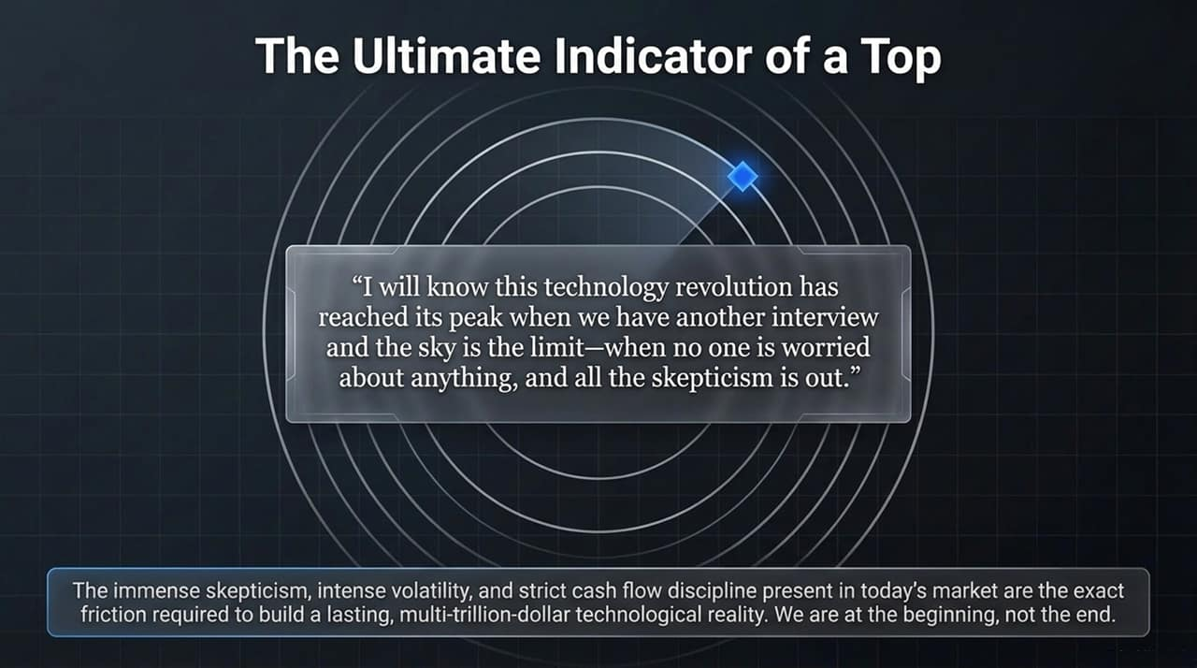
Notes:
1999 Reality Check:
In 1999, market multiples were driven by speculative assumptions around web traffic and potential reach, well before real unit economics existed.
Modern Innovation Era Reality:
Today’s growth is anchored by high hardware utilization, rapid product adoption, and significant productivity gains.
The Benchmark Blind Spot:
Traditional broad market indices remain heavily weighted toward mature, legacy mega-cap benchmarks.
This creates a blind spot that leaves index-only investors under-allocated to pure-play disruptive platforms emerging outside legacy benchmark holdings.

Slide 16
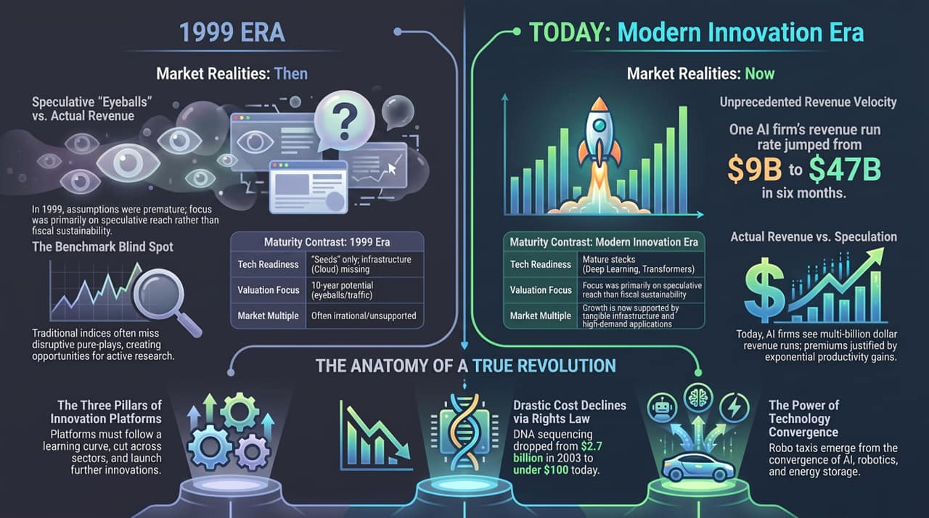
Notes:
Synthesizing the Core Framework:
To wrap up our analysis of Slides 1 through 15, let's summarize the four core takeaways of this technological revolution:
Wright’s Law Cost Declines: Predictable cost reductions drive rapid market expansion (e.g., DNA sequencing dropping from $2.7B to under $100).
Multi-Platform Convergence: Combined platforms accelerate adoption (e.g., AI, Robotics, and Energy Storage converging to create Autonomous Robo-Taxis).
Real Revenue Velocity: Value creation is supported by actual enterprise revenue growth, not speculative metrics.
Active, Long-Term Horizon: Capturing this value requires moving beyond benchmark-sensitive indexing to maintain a 5-year investment horizon through market volatility.

